Slide 1
Divisibility

Slide 2
Quiz
Everyone will get another attempt
If you’re already happy with your grade
Come back at 6:30

Slide 3
Number theory
Branch of mathematics devoted to integers and arithmetic functions

Slide 4
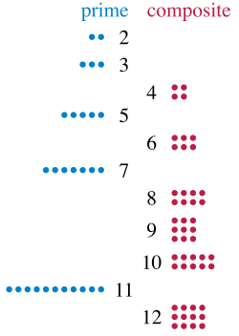
Prime numbers and Composite numbers
Prime – only positive factors are 1 and itself
Composite – product of 2 smaller numbers

Slide 5
Fundamental Theorem of Arithmetic
For all integers greater than 1
They are either prime
Or can be represented by a unique* product of prime numbers
*Provided you don’t care about the order)
Aka a combination
I generated some random numbers
76 = 2 *2 * 19
432 = 2 * 2 * 2 * 2 * 3 * 3 * 3
= 2⁴ * 3³
33 = 3 * 11
14 = 7 * 2
A theorem is a statement that has been proven to be true (in the mathematical “proof” sense)

Slide 6
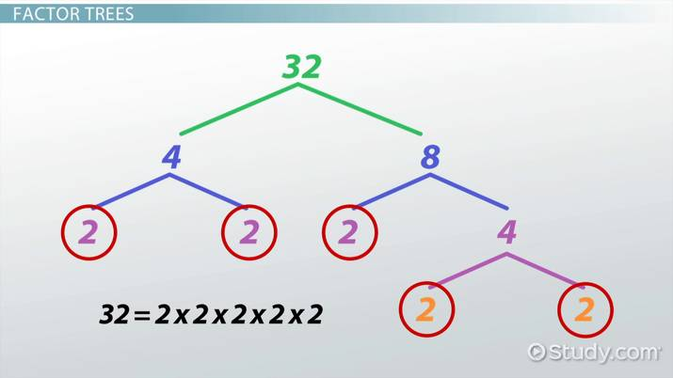
Prime factorization
Identify all primes required to multiply together to make any number

Slide 7
But I do not wish to make a factor tree
I want my CODE to do it
That’s why I write code
So I can’t mix up numbers

Slide 8
Lets work together to make an algorithm to make Python do this
Yes a lot exist online already but lets talk it over

Slide 9
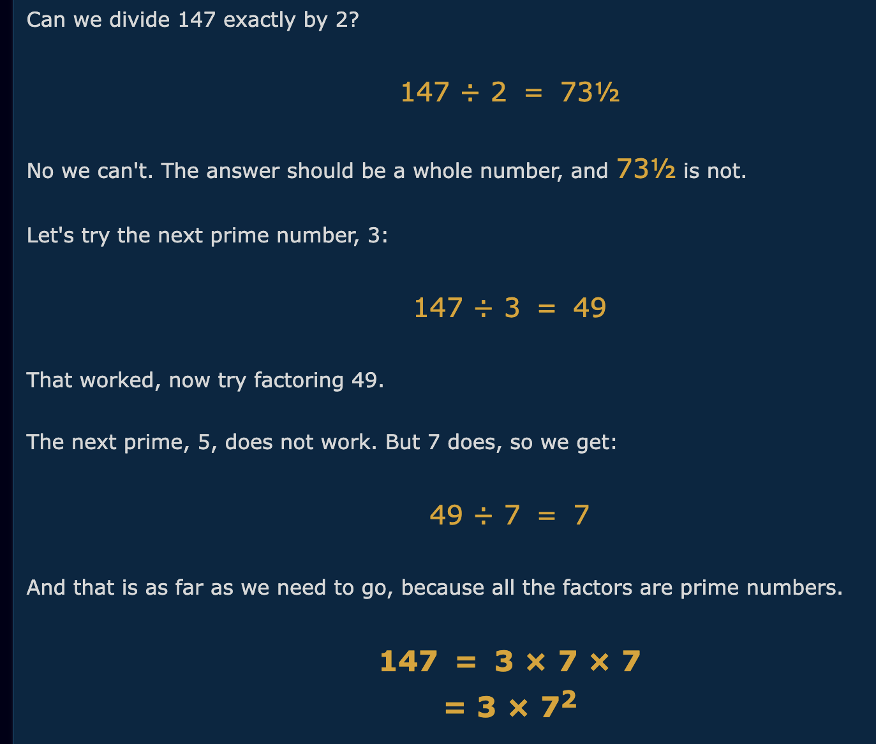
My usual starting point: how do humans do it?
What “steps” do you see here?
What shortcuts can we take as humans?

Slide 10
My idea:
Divide by 2 as many times as you can
For a number like 8 – that’s all that you need
For something like 6 – we need another step…
Divide by 3 as many times as we can
Solves our problem with 6
Doesn’t solve our problem for 25
Divide by 5 as many times as we can
Not 4 – dividing by 2 should have taken care of any even factors
Keep repeating with odds

Slide 11
Cool! A loop - But when do we stop?
Lets look at some factors and see if we can’t identify a pattern
WAYS TO MAKE 12
1 * 12
2 * 6
3 * 4
4 * 3
6 * 2
12 * 1
We hit a point where there’s always a “mirror image” of our earlier factors

Slide 12
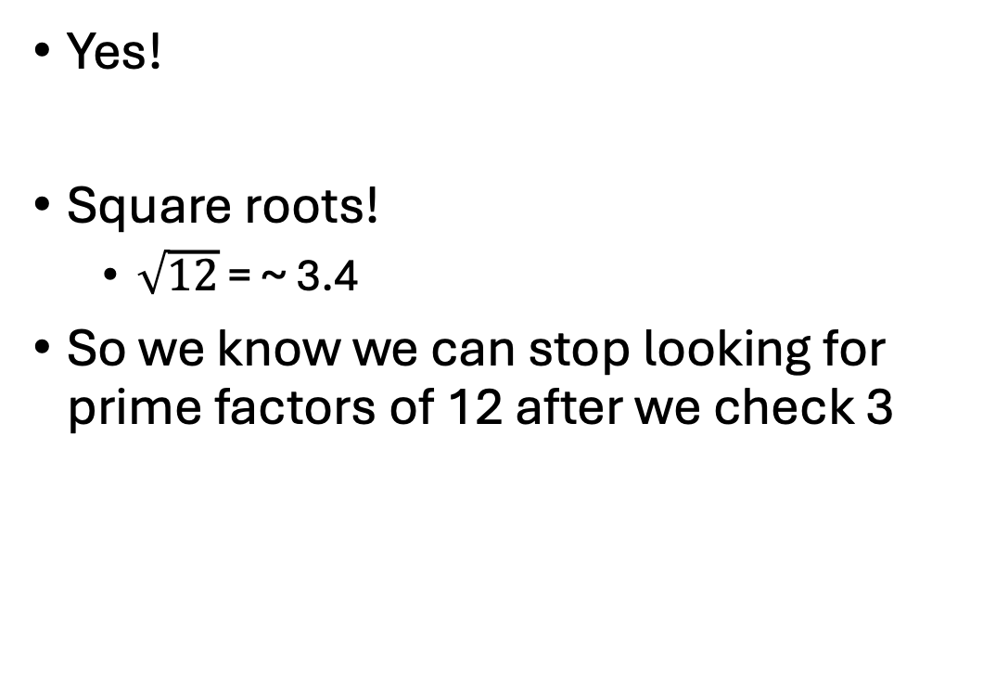
Ok – Is there a way we can find that “mirror image” point?
Yes!
Square roots!
$\sqrt{12}$ = ~ 3.4
So we know we can stop looking for prime factors of 12 after we check 3
WAYS TO MAKE 12
1 * 12
2 * 6
3 * 4
4 * 3
6 * 2
12 * 1

Slide 13
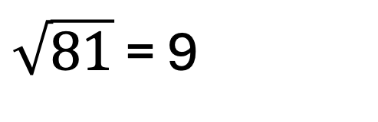
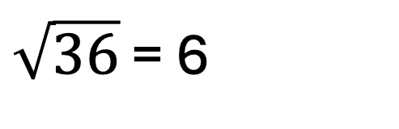
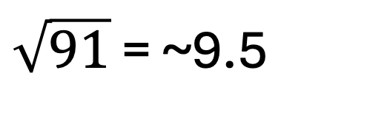
Does this work for any number?
Factors of 36
1 * 36
2 * 18
3 * 12
4 * 9
6 * 6
Factors of 81
1 * 81
3 * 27
9 * 9
Factors of 91
1 * 91
7 * 13
$\sqrt{36}$ = 6
$\sqrt{81}$ = 9
$\sqrt{91}$ = ~9.5
Yeah!

Slide 14
So back to our algorithm
Divide by 2 as many times as you can
For a number like 8 – that’s all that you need
For something like 6 – we need another step…
Divide by 3 as many times as we can
Solves our problem with 6
Doesn’t solve our problem for 25
Divide by 5 as many times as we can
Not 4 – dividing by 2 should have taken care of any even factors
Keep repeating with odds
UNTIL we try the odd number <= to our square root

Slide 15
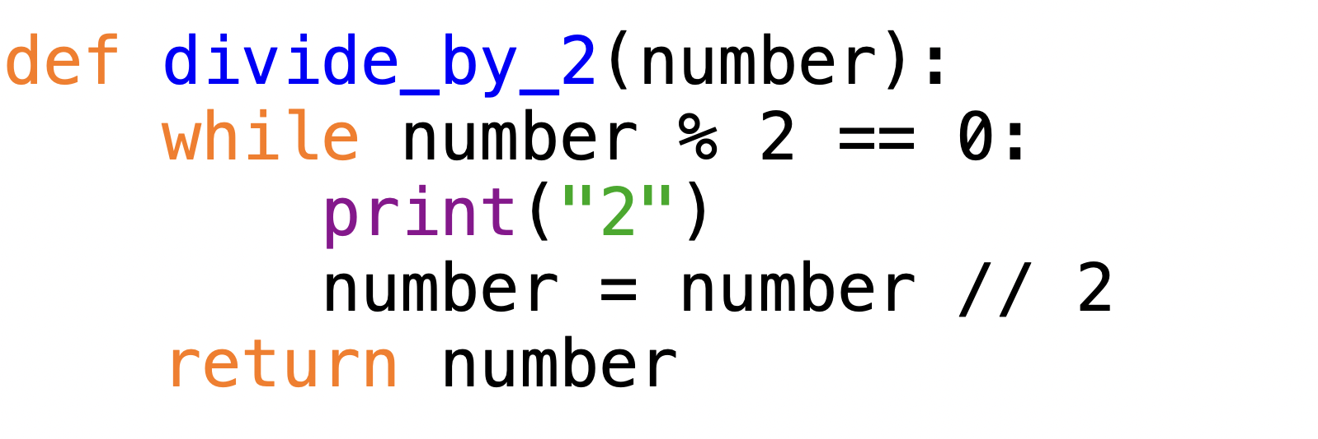
Divide by 2 as many times as you can
UNTIL we get an odd number
Repeatedly divide by 2

Slide 16
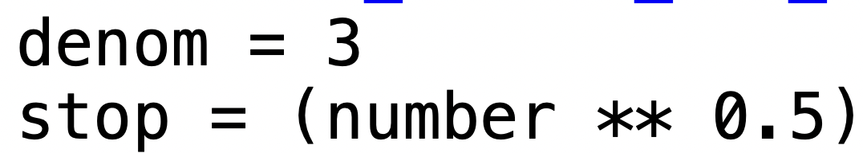
From 3 until the square root…

Slide 17
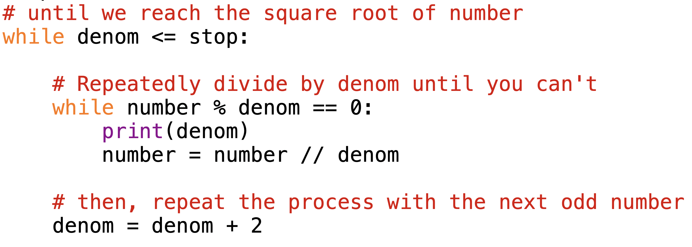
From 3 until the square root… Divide by that number as many times as you can

Slide 18
Isn’t it kind of inefficient to try everything?
Yeah
Nobody has a better way yet
This is to your benefit
We’ll talk about cryptography another day though

Slide 19
I have 2 different implementations online
One from these slides
One I built after that I like better?
Read em over and see what makes sense to you
I stuck to only whiles
Since that’s where my current 5001 students are at
But for loops would simplify

Slide 20
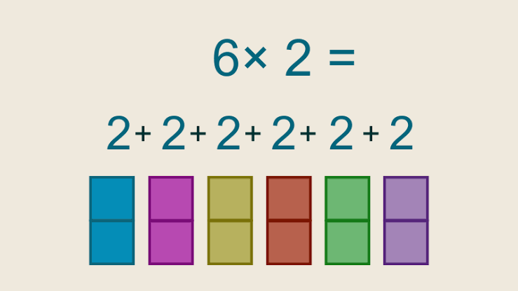
Can any positive integer be represented as the sum of a bunch of primes?
Multiplication can be represented as addition

Slide 21
Divisibility

Slide 22
Divisibility
In Python:
a % b == 0
True means a is evenly divisible by b
In Math… a|b

Slide 23
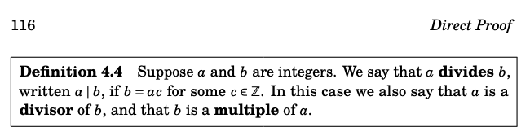
a | b
Meaning we can divide a by b and get a whole number
Put another way…
There is some number (c) we can multiply by a to get b
Ex.
3 | 12
There is some number (4) that we can multiply by 3 to get 12

Slide 24
a | b
Oh hey a predicate!
If we plug in values for a and b we get a strictly true or false statement!
5 | 10 ← True (since 5 * 2 is 10)
44 | 3 ← False

Slide 25
GCD
Greatest Common Divisor
Largest integer that divides 2 different numbers
gcd(12, 15) = 3
Formal definition
Let a, b ∈ Z. The greatest common divisor of a and b (denoted gcd(a, b)) is the largest integer g such g divides both a and b

Slide 26
gcd and factorization
Lets say we had a set of all prime numbers ever
P = {P₁, P₂, P₃, P₄, …. P_{n}}
We can express any number as…
A = P₁^{a1} * P₂^{a2} * P₃^{a3} * … P_{n}^{an}
Too many exponents for unique letters so we start combining numbers and letters
Given 2 numbers
A = P₁^{a1} * P₂^{a2} * P₃^{a3} * … P_{n}^{an}
B = P₁^{b1} * P₂^{b2} * P₃^{b3} * … P_{n}^{bn}
gcd(A, B) = P₁^{min(a1,b1)} * P₂^{min(a2,b2)} * P₃^{min(a3,b3)} * … P_{n}^{min(an,bn)}
Write that down for now and we’ll come back to it later

Slide 27
LCM
Least common multiple

Slide 28
LCM – Quick Refresher
L = Least (aka smallest)
C = Common (aka shared)
M = Multiple
x is a multiple of y
y * something else = x

Slide 29
LCM in terms of primes
Lets look at those primes again
15 = 3 * 5
12 = 2² * 3
Any CM is going to need to involve all of the required primes to make 12 and 15
2²
3
5
The LCM won’t include any other numbers
(otherwise it wouldn’t be least)
2² * 3 * 5 = 60
Therefore lcm(15, 12) = 60

Slide 30
We have two 2s but not two 3s?
Not quite sets but also pretty similar
Numbers needed to make 15
5
Numbers needed to make 12
2, 2
3

Slide 31
Quick LCM practice
lcm(77, 121)
77 = 7 * 11
121 = 11²
lcm(48, 33)
48 = 2 * 2 * 2 * 2 * 3
33 = 3 * 11
7 * 11² = 847
2⁴ * 3 * 11 = 528

Slide 32
Going back to that weird expression of primes
gcd(A, B) = P₁^{min(a1,b1)} * P₂^{min(a2,b2)} * P₃^{min(a3,b3)} * … P_{n}^{min(an,bn)}
lcm(A, B) = P₁^{max(a1,b1)} * P₂^{max(a2,b2)} * P₃^{max(a3,b3)} * … P_{n}^{max(an,bn)}

Slide 33
Lets look at 12 and 15 again
12 = 1⁰ * 2² * 3¹ * 5⁰ …P_{n}⁰
Basically 2² * 3¹ * a huge number of 1s
15 = 1⁰ * 2⁰ * 3¹ * 5¹ …P_{n}⁰
Basically 3¹ * 5¹ * a huge number of 1s
gcd(12, 15) = 1^{min(0,0)} * 2^{min(2,0)} * 3^{min(1,1)} * 5^{min(0,1)} ….* P_{n}^{min(0,0)}
3¹ * a lot of 1s = 3
lcm(12, 15) = 1^{max(0,0)} * 2^{max (2,0)} * 3^{max (1,1)} * 5^{max (0,1)} ….* P_{n}^{max(0,0)}
2² * 3¹ * 5¹ * a lot of 1s = 60

Slide 34
The Euclidian Algorithm
A talk through the building blocks

Slide 35
It is possible to calculate gcd without factorization
gcd(21, 54)
Identify which number is bigger
54 > 21
How many times does the smaller number appear in the bigger number
54 // 21 = 2
54 goes into 21 2 times (but there may be leftovers)
Subtract those copies of smaller from bigger
54 – (21 * 2) = 12
(step 4 on next slide)

Slide 36
Repeat until you have small enough numbers to work with
gcd(21, 54)
Identify which number is bigger
21 > 12
How many times does the smaller number appear in the bigger number
21 // 12 = 1
21 goes into 12 1 times (but there may be leftovers)
Subtract those copies of smaller from bigger
21 – (12*1) = 9
AGAIN
Now gcd (21, 12)
gcd(9,3)
Now gcd (9, 12)
12 > 9
9 > 3
12 // 9 = 1 9 goes into 12 one time 1 (with some leftover…)
9 // 3 = 3
3 goes into 9 3 times (with some left over?)
12 – 9 = 3
9 – 3 * 3 = 0
Gcd(3,0) Now that one is 0, we know the gcd of everything must be 3

Slide 37
A visual explanation

Slide 38
A visual explanation
54 – 21*2 = 12

Slide 39
A visual explanation
21 – 12*1 = 9

Slide 40
A visual explanation
12 - 9 = 3

Slide 41
Another visual
54 – 21 * 2 = 12

Slide 42
Another visual
21 – 12 = 9

Slide 43
Another visual
12 – 9 = 3

Slide 44
Another visual
9 / 3 * 3 = 0

Slide 45
Ok so this works but
gcd(0, n ) = n and n|0 is always true There is some number (0) we can multiply by any number to get 0
Aka how do we know our problems are analogous
We can kind of see that gcd(54, 21) = gcd(12, 9) = gcd(3, 0)
But why is shrinking our problem ok
How do we know gcd(a,b) is the same as gcd(a, b-a)
Why can we shrink perform these reductions and still get the right answer

Slide 46
Lets look at the proof
g = gcd(a,b)
g|a is true
so g * some number (x) = a
gx = a
g|b is true
so g * some other number (y) = b
gy = b
a-b
Put another way is
a-b = gx – gy
= g(x-y)
And we’ve reached our definition of divides
G can be multiplied by some other number (whatever x-y is) to get a-b
g|a-b

Slide 47
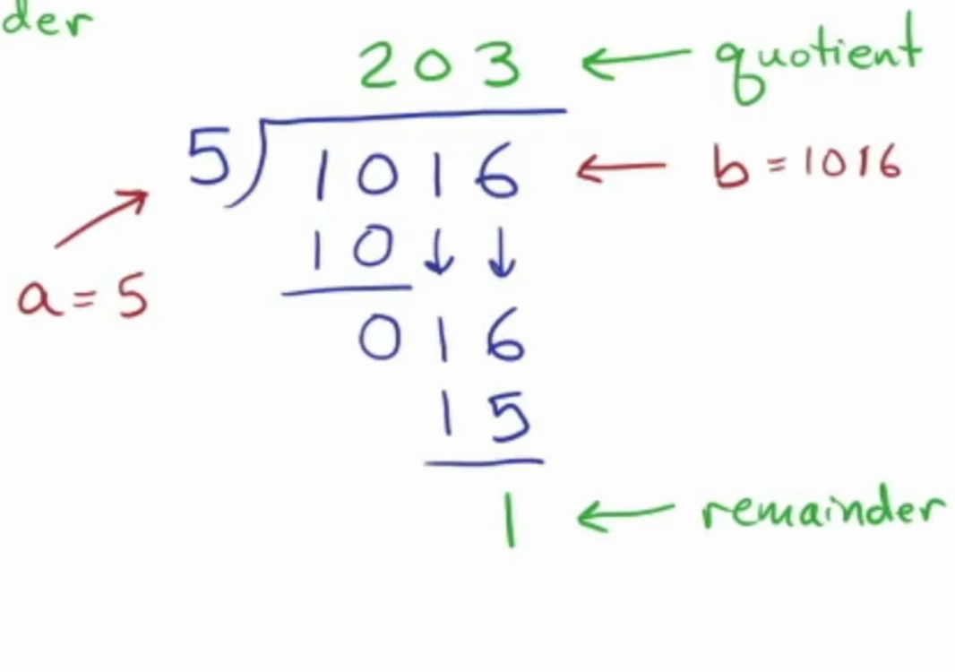
Can we do better
If a and b are integers and b>a
b = quotient * a + remainder
Shortened to b = qa + r
For some ints q and r
Where 0<= r <= a

Slide 48
Euclidian algorithm with no subtraction needed
Start with a pair a,b where a < b
While neither a nor b are 0
Find the r in the expression b=aq+r
Overwrite whatever b was to be whatever value a stores
Overwrite whatever a was to be whatever value r is
Once you’re done
The non-zero entry is the gcd
Try this algorithm with gcd(180, 196)
Or write some python to do it for you

Slide 49
gcd(180, 196)
Start with a pair a,b where a < b
While neither a nor b are 0
Find the r in the expression b=aq+r
Overwrite whatever b was to be whatever value a stores
Overwrite whatever a was to be whatever value r is
Once you’re done
The non-zero entry is the gcd
a = 180, b = 196
a = 16, b = 180
a = 4, b = 16
r = b % a = 16
r = b % a = 180 % 16 = 4
r = b % a = 16 % 4 = 0
b = 180
b = 16
b = 4
a = 16
a = 4
a = 0
gcd = 4

Slide 50
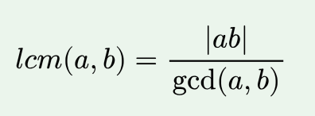
In python…demo? Or make students figure it out for themselves…
Start with a pair a,b and assume a < b
While neither a nor b are 0
Find the r in the expression b=aq+r
Overwrite whatever b was to be whatever value a stores
Overwrite whatever a was to be whatever value r is
Once you’re done
The non-zero entry is the gcd
conditionals
If you finish it early…
Then you’re free for the night

